Slide 2
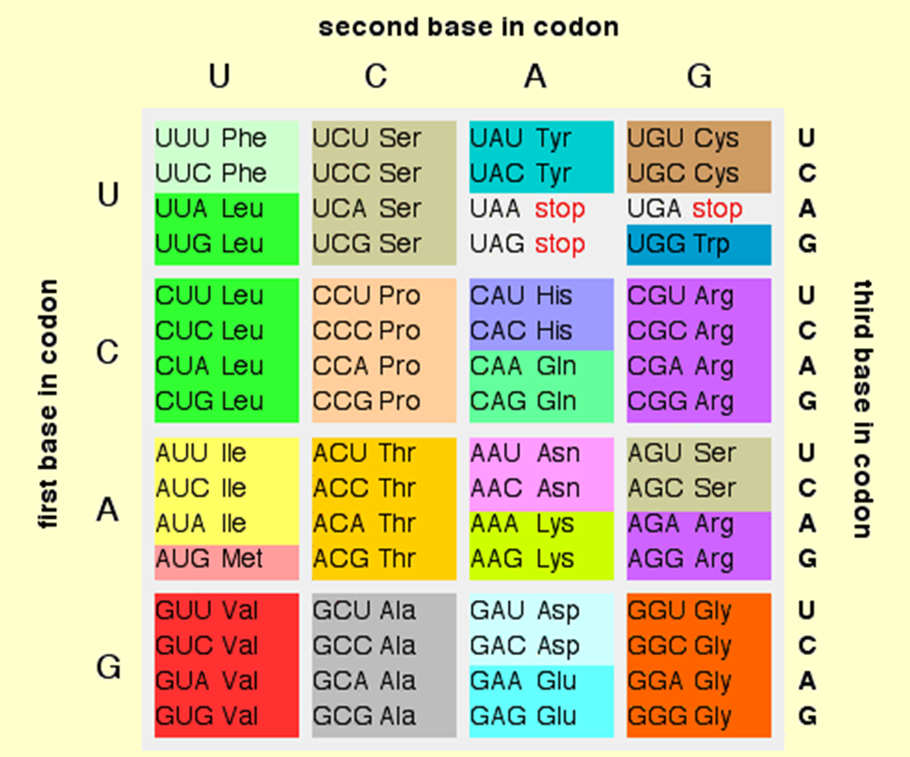
Triplet code/ mRNA to Protein code

Slide 3
Activity- Translate to proteins
TGG CCA TGC GCA AGC TGG TGC GCT CAG
TGG CCA TGC GCA ACC TGG TGC GCT CAG

Slide 4
Speed and Precision of DNA replication
Polymerase 700 bp per sec
Errors 1 in 10^7 nucleotides
With proof-reading 1 in 10^9 nucleotides

Slide 5
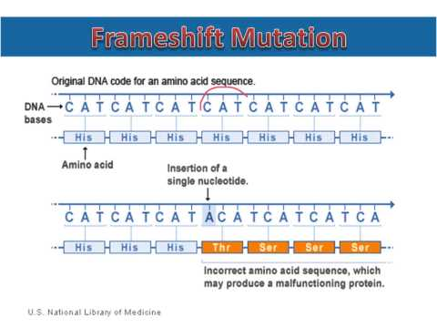
Frame-shift mutation

Slide 6
Frame-shift mutation

Slide 7
Genbank
https://www.ncbi.nlm.nih.gov/genbank/statistics/
First genome sequenced in 1995
(the bacteria H. influenzae with a
genome of 1,830,140 letters).

Slide 8
Basic BI tools
NCBI database
Uniprot, Prosite, Protparm, SNP
EXPASY
BLAST
ClustalW
Pdb or RCSB

Slide 9
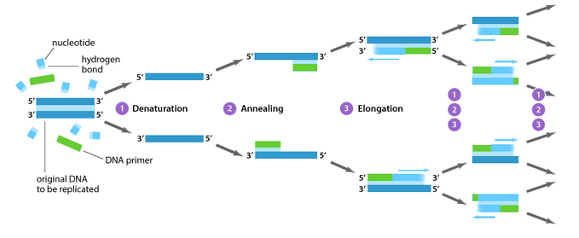
PCR-Polymerase Chain Reaction
https://www.youtube.com/watch?v=iQsu3Kz9NYo

Slide 10
PCR- reaction set up
Template DNA
dNTPs, i.e., dATP, dGTP, dCTP and dTTP
Taq polymerase that works at high temperature- made from a thermophilic organism

Slide 11
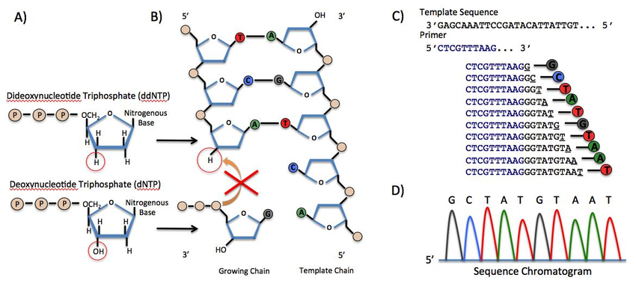
dNTPs vs ddNTPs

Slide 12
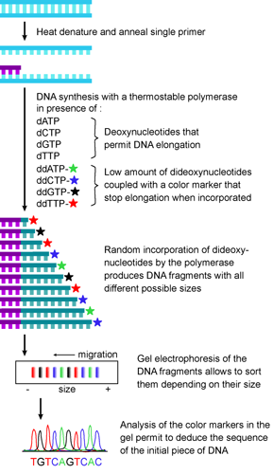
Incorporation of ddNTPs stops the PCR extension reaction

Slide 13
Stepwise sequence of events
AAGTCGATCGTGAGAGCTA
Let us concentrate on just one strand for understanding the events
ddATP
ddGTP
ddCTP
ddTTP
The concentration is chosen such that there is a random incorporation of the different dNTPS at different instances

Slide 14
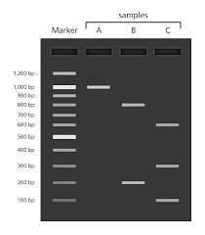
Principle of Electrophoresis
DNA is a charged molecule. It is a negatively charged molecule.
Therefore, it can migrate towards anode [positive electrode].
The shorter DNA fragments migrate faster through the pores of an agarose gel.

Slide 15
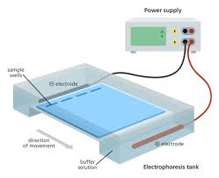
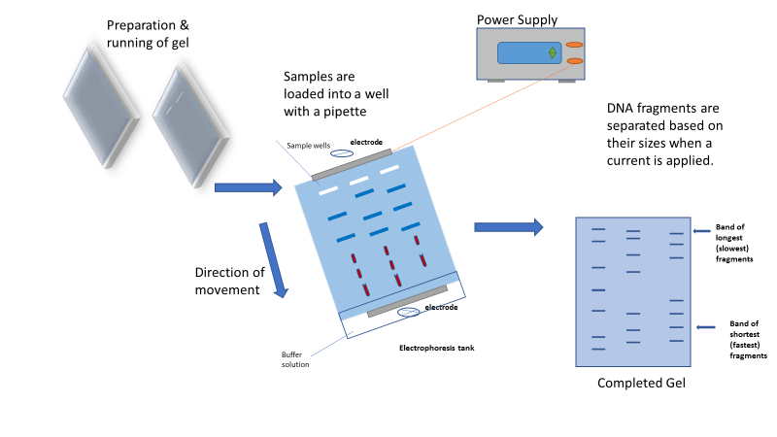
Electrophoresis

Slide 16
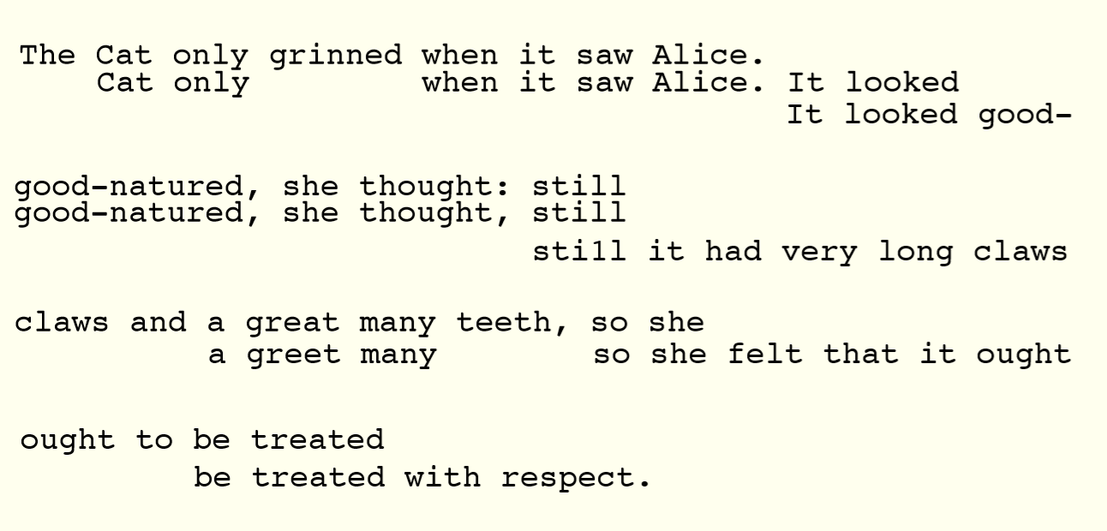

Slide 17
Sanger sequencing
It did not have these color coded dNTPs but had to use radiolabelled dNTPs.
In Sanger sequencing, the target DNA is copied many times, making fragments of different lengths. Fluorescent “chain terminator” nucleotides mark the ends of the fragments and allow the sequence to be determined.
In the Human Genome Project, Sanger sequencing was used to determine the sequences of many relatively small fragments of human DNA. (These fragments weren't necessarily 900900900 bp or less, but researchers were able to "walk" along each fragment using multiple rounds of Sanger sequencing.) The fragments were aligned based on overlapping portions to assemble the sequences of larger regions of DNA and, eventually, entire chromosomes.

Slide 18
Next generation sequencing
Next-generation sequencing techniques are new, large-scale approaches that increase the speed and reduce the cost of DNA sequencing.
https://www.ebi.ac.uk/training/online/course/ebi-next-generation-sequencing-practical-course/what-next-generation-dna-sequencing/454-seque

Slide 19
Huge amount of data now available, need algorithms to make sense of it.
Next up: sequence comparison using dynamic programming.

Slide 20
Example and activity
Incorporation of ddNTPs will stop the extension reaction.
AAGTCGATCGTGAGAGCTA
A
AA
AAGTCGA
AAGTCGATCGTGA
AAGTCGATCGTGAGA
AAGTCGATCGTGAGAGCTA

Slide 21
Activity
Incorporation of ddNTPs will stop the extension reaction.
AAGTCGATCGTGAGAGCTA
Now write down the length of each of the extended sequences above
A
AA
AAGTCGA
AAGTCGATCGTGA
AAGTCGATCGTGAGA
AAGTCGATCGTGAGAGCTA
AAG
AAGTCG
AAGTCGATCG
AAGTCGATCGTG
AAGTCGATCGTGAG
AAGTCGATCGTGAGAG
AAGTC
AAGTCGATC
AAGTCGATCGTGAGAGC
AAGT
AAGTCGAT
AAGTCGATCGT
AAGTCGATCGTGAGAGCT

Slide 22
Activity
Incorporation of ddNTPs will stop the extension reaction.
AAGTCGATCGTGAGAGCTA
Now write down the length of each of the extended sequences above
A
AA
AAGTCGA
AAGTCGATCGTGA
AAGTCGATCGTGAGA
AAGTCGATCGTGAGAGCTA
AAG
AAGTCG
AAGTCGATCG
AAGTCGATCGTG
AAGTCGATCGTGAG
AAGTCGATCGTGAGAG
AAGTC
AAGTCGATC
AAGTCGATCGTGAGAGC
AAGT
AAGTCGAT
AAGTCGATCGT
AAGTCGATCGTGAGAGCT

Slide 23
